Slide 1
Scott Hunter
VP Director Product, Azure Developer
@coolcsh

Slide 2

Agenda
  Microsoft Loves Java
  Microsoft is part of the Java Community
  Microsoft is contributing to Java
  Microsoft uses lots of Java
  Java + Visual Studio Code / GitHub / Azure
  Playwright for testing Java Apps
  Azure Container Apps for Java Apps

Slide 3
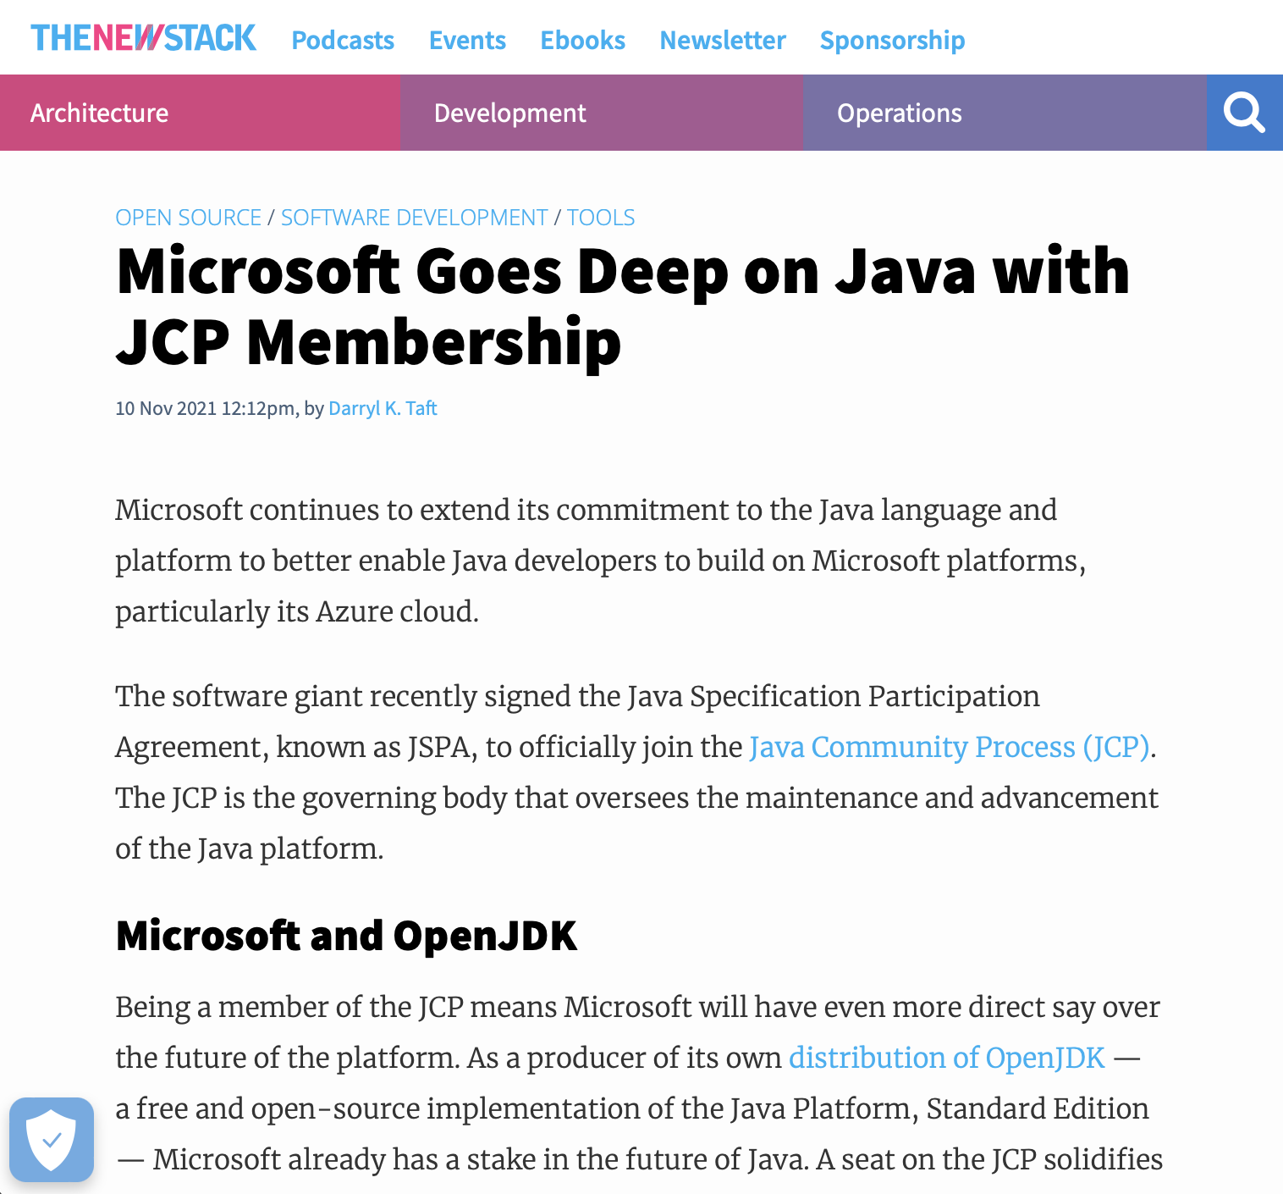
Microsoft is part of
the Java Community Process

Slide 4



Community engagement
Toolkit and plug-ins to improve Eclipse dev experience
Fixes, performance enhancements, new ports, commercial support on Azure
Sponsor and project contributor to Eclipse Adoptium
Spring Cloud for Azure project and managed service for Spring Boot

Slide 5

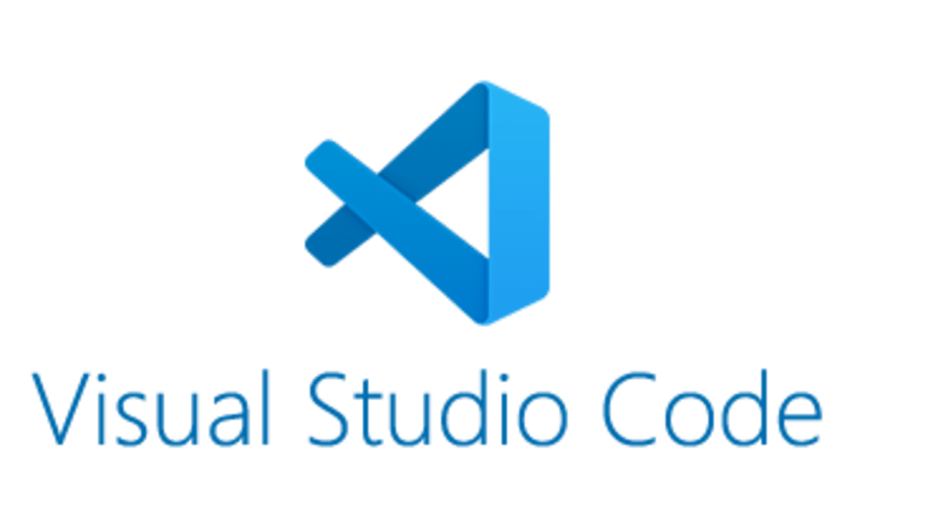



Community engagement
3.6M+ Java repositories hosted, free support and resources for Java devs
Java extensions for Maven, Run/Debug, Unit Testing and more
Support for open standards like Jakarta EE and MicroProfile
Member of the JCP to directly contribute with Java specifications

Slide 6

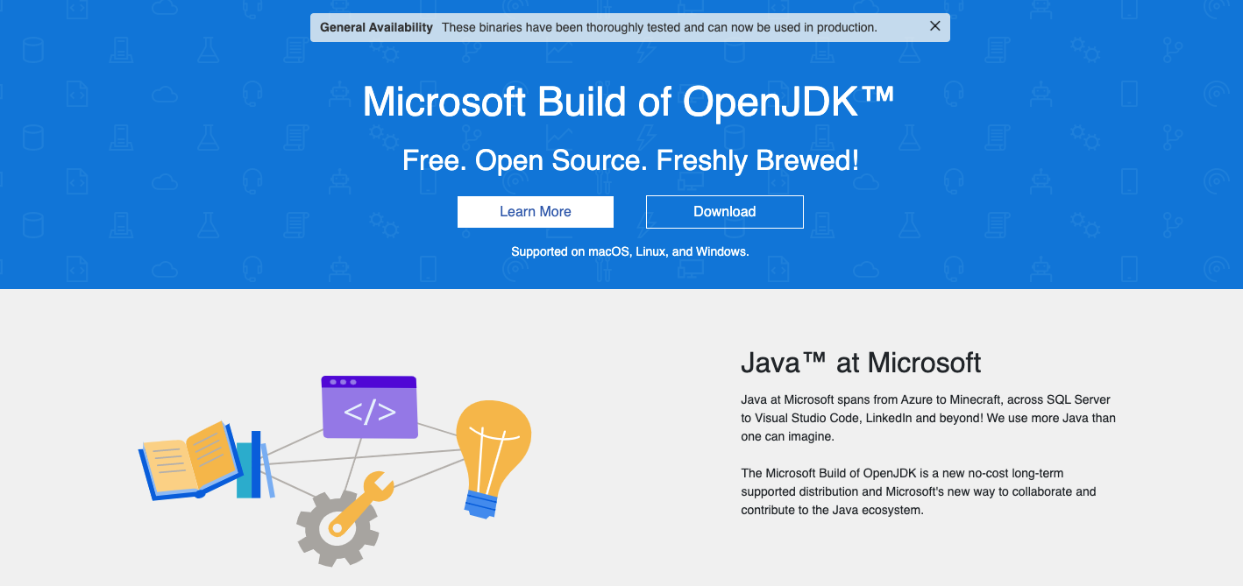
Microsoft Build of OpenJDK
microsoft.com/openjdk

Slide 7
Microsoft Build of OpenJDK
microsoft.com/openjdk
OpenJDK 11 & 17
Linux, Alpine, macOS, Windows
X86-64, Arm64, and Apple Silicon

Slide 8
Microsoft Build of OpenJDK
microsoft.com/openjdk
Container Images
mcr.microsoft.com/openjdk/jdk

Slide 9
Microsoft Build of OpenJDK
microsoft.com/openjdk
Installers
.MSI, .PKG, .DEB, .RPM
TAR.GZ, ZIP packages
Homebrew, WinGet, SDKMan!

Slide 10
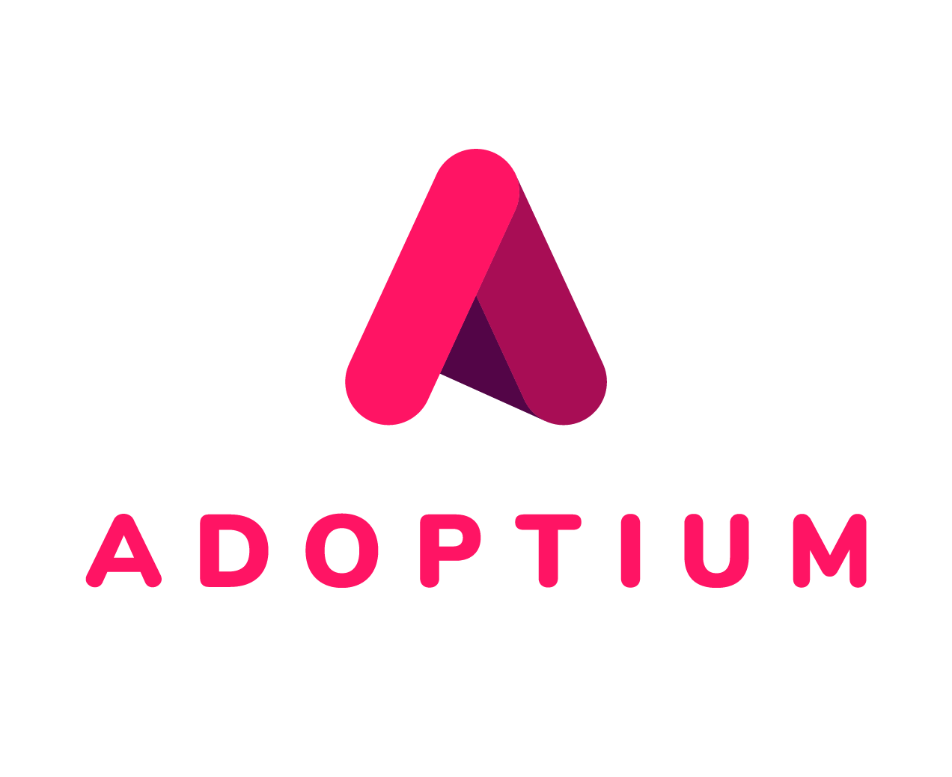
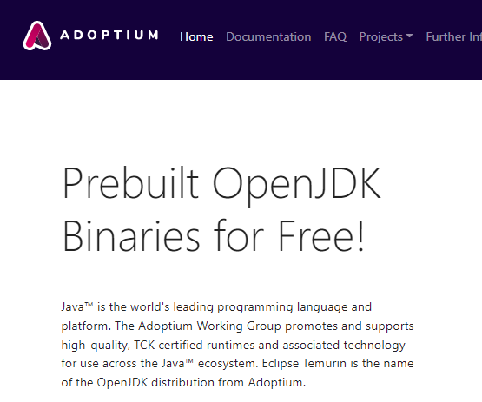
Eclipse Adoptium
adoptium.net
Community-led, vendor neutral binaries of OpenJDK

Slide 11
OpenJDK Ports
Windows on Arm, Apple Silicon, and Alpine Linux
OpenJDK mainstream:
  JEP 388: Windows/AArch64
  JEP 391: macOS/AArch64 Port
Eclipse Adoptium:
  Backported support for Alpine Linux/musl in Java 8 binaries

Slide 12
We use Java.
A lot.

Slide 13






Java is widely used across Microsoft
2 million JVMs
in production *
LinkedIn
Azure
Yammer
Minecraft
Bing
MSN
* Internal systems. Does not include customer workloads.

Slide 14

Minecraft:
Java Edition
Runs on Java 17
Powered by Microsoft Build of OpenJDK
10+ millions of players
  Learn more
  minecraft.net/article/minecraft-1-18-pre-release-2

Slide 15
Minecraft:
Java Edition
“
LeopardShark
From my testing, it provides about a ten percent performance boost.
TheMCNerd2014
Moving to Java 17 means huge improvements for modding and datapacks (tons of new features and performance improvement)
”
  Learn more
  minecraft.net/article/minecraft-1-18-pre-release-2

Slide 16
Java developers deserve awesome tools

Slide 17





You can build Java apps with Microsoft tools
Playwright
enables reliable
end-to-end testing for modern web apps
GitHub Copilot
gives suggestions for whole lines or entire functions
Windows Subsystem
for Linux
is an environment Java devs are familiar with
Visual
Studio Code
enables developers to code smarter, faster
GitHub Actions
is for automating your workflow from idea to production
playwright.dev/java
copilot.github.com
aka.ms/wsl
aka.ms/java-vscode
aka.ms/github-actions-java

Slide 18

Visual Studio Code for Java
1.5M+
Active Java Developers on VS Code

Slide 19






Azure Has Great Support for Java Developers
  Managed Java runtimes with certified OpenJDK builds
  Java 8, Java 11, and Java 17
  Commercial support for Azure customers
  Spring Framework
  Solutions jointly built with VMWare
  Java EE and Jakarta EE standards
  Certified application servers from partners

Slide 20





Modernize Java apps on Azure
Infrastructure-as-a-service
Container platform-as-a-service
Platform-as-a-service
Virtual machines
Virtual Machine
Scale Sets
Azure Kubernetes Service
Azure Red Hat OpenShift
Azure Container Apps
Azure App Service
Azure Spring Cloud
Java SE
Tomcat
JBoss EAP
Spring Apps
Control
Productivity
Azure has hosting options whether you want full control,
focus on developer productivity, or be somewhere in between.

Slide 21
Bruno Borges
Principal Product Manager, Java
@brunoborges
Rory Preddy
Principal Content Engineer, Java
@rorypreddy

Slide 22
Code, Deploy, Scale Java your way with Microsoft

Slide 23
Code
Deploy
Scale
  Code using the
  tools that make
  Java developers the most productive and support collaboration with others.
  Using your favorite frameworks and services without worrying about infrastructure – from fully managed to jointly supported offerings from VMWare, Red Hat, Oracle, IBM, and others.
  Using a wide range of automation tools and platforms, with state-of-the-art security and monitoring features, and auto-scaling.

Slide 24
Java Your Way with Microsoft
Code
Deploy
Scale
  Microsoft Build of OpenJDK
  IntelliJ and Eclipse IDEs
  Visual Studio Code
  GitHub Codespaces
  Azure SDKs
  Playwright
  Windows and WSL

Slide 25
Java Your Way with Microsoft
Code
Deploy
Scale
  GitHub Actions
  Azure DevOps
  Azure CLI
  Apache Maven and Gradle plugins

Slide 26
Java Your Way with Microsoft
Code
Deploy
Scale
  Azure Functions
  Azure App Service
  Azure Container Apps
  Azure Kubernetes Service
  Azure Spring Cloud
  Azure Red Hat OpenShift
  Azure App Insights

Slide 27
Recap
  Microsoft Loves Java
  Microsoft is part of the Java Community
  Microsoft is contributing to Java
  Microsoft uses lots of Java
  Java + Visual Studio Code / Github / Azure
  Playwright for testing Java Apps
  Azure Container Apps for Java Apps

Slide 28
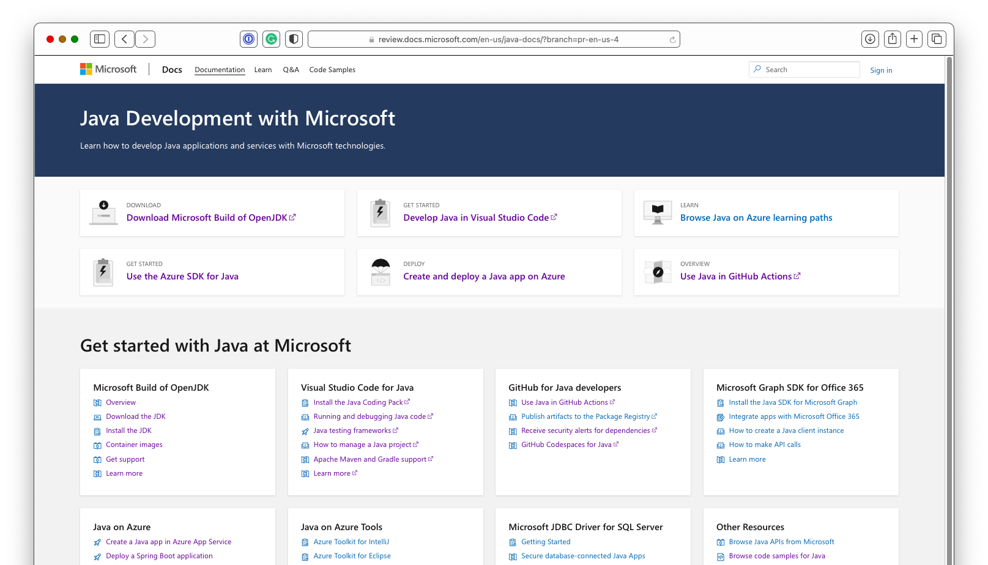
Microsoft Documentation Hub for Java
  docs.microsoft.com/java

Slide 29
Get in touch!
Twitter
@JavaAtMicrosoft
Java at Microsoft Blog
devblogs.microsoft.com/java/

Slide 31
Microsoft Build

